Slide 1



MCSE 666:
Pattern and Speech Recognition
Aspect & Prospect
Dr. Md. Aminul Haque Akhand Dept. of CSE, SUB

Slide 2
PG Course: Instructor vs. Student Qualification and Contribution
2
PhD
MSc
UG
Instructor
Instructor
HSC
SSC
PSC
PSC SSC HSC
UG MSc
Student
Student
Qualification
Contribution

Slide 3

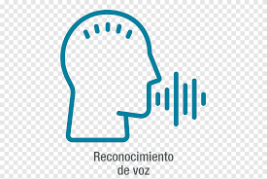
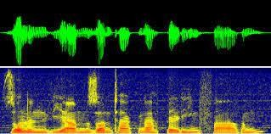
Pattern and Speech Recognition (PSR)
3
Pattern
Speech Recognition

Slide 4
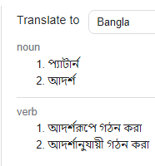
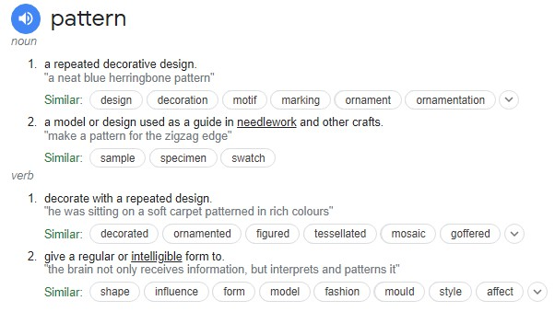
PSR Individual Terms: Pattern
4

Slide 5
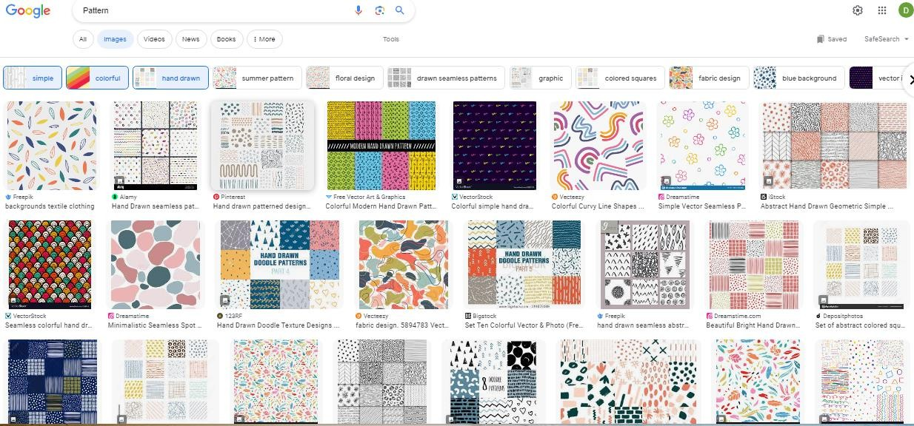
PSR Individual Terms: Pattern
5
A pattern is a regularity in the world, in human-made design, or in abstract ideas. The elements of a pattern repeat in a predictable manner. A geometric pattern is a kind of pattern formed of geometric shapes and typically repeated like a wallpaper design.

Slide 6
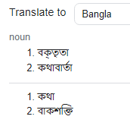
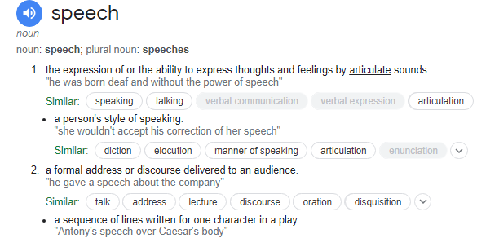
PSR Individual Terms: Speech
6

Slide 7
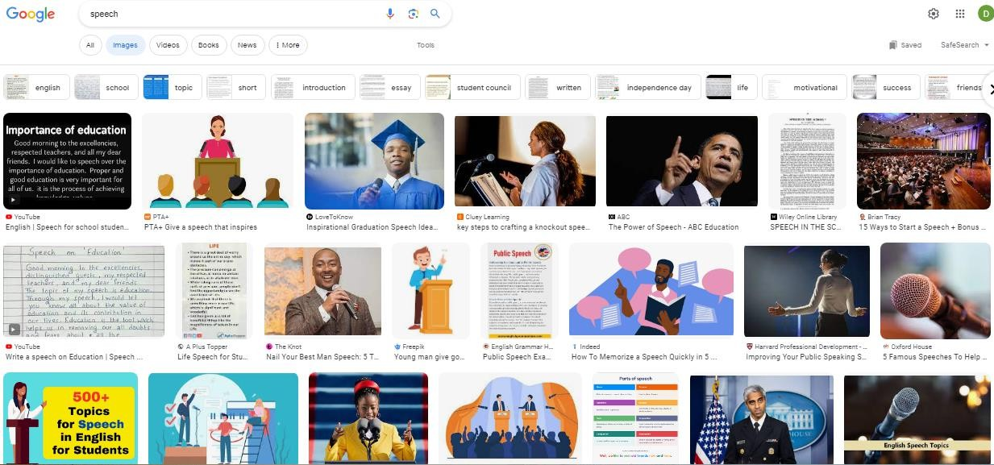
PSR Individual Terms: Speech
7
Speech, language refer to the means of communication used by people. Speech is the expression of ideas and thoughts by means of articulate vocal sounds, or the faculty of thus expressing ideas and thoughts.

Slide 8
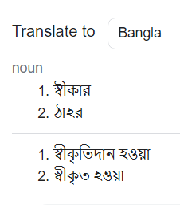
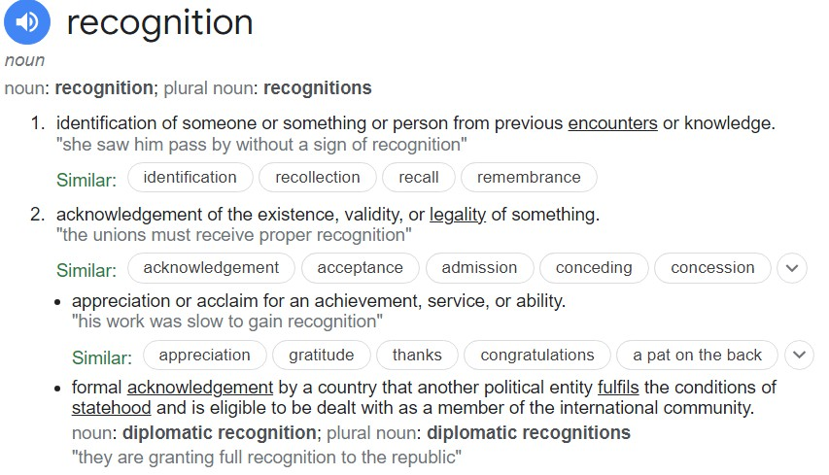
PSR Individual Terms: Recognition
8

Slide 9

PSR Individual Terms: Recognition
9
Recognition in sociology is the public acknowledgment of a person's status or merits (achievements, virtues, service, etc.).
Another example of recognition is when some person is accorded some special status, such as title or classification.

Slide 10
Pattern and Speech Recognition (PSR)
10
Pattern Speech Recognition
Speech Pattern Recognition
Pattern Recognition and
Speech Recognition
Intelligent Pattern Recognition and
Intelligent Speech Recognition

Slide 11
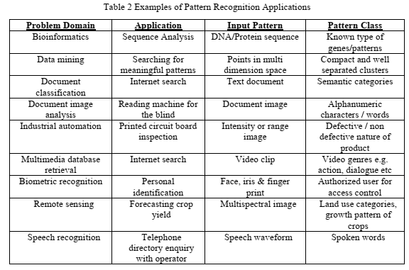
Examples of Pattern Recognition
11
Mayank Parasher et al., Anatomy on Pattern Recognition, June 2011, Indian Journal of Computer Science and Engineering 2(3)

Slide 12
Examples of Pattern Recognition
12
What Are the Real-World Applications of Pattern Recognition?
https://serokell.io/blog/applications-of-pattern-recognition
10 Real Life Examples Of Pattern Recognition
https://numberdyslexia.com/pattern-recognition-real-life-examples/
Pattern recognition and use in real life problem solving
https://suresolv.com/problem-solving-techniques/pattern-recognition-and-use- real-life-problem-solving
What is pattern recognition and why it matters? Definitive guide
https://theappsolutions.com/blog/development/pattern-recognition-guide/

Slide 13
MCSE 666: Pattern and Speech Recognition
13
SUB MCSE 666 Syllabus or Course Outline
Introduction to formal languages and patterns; string languages for pattern description; higher dimensional pattern grammars; syntax analysis as a recognition procedure; stochastic languages; error correcting parsing for string languages; error-correcting tree automata; cluster analysis for syntactic patterns; grammatical inference for syntactic pattern recognition; syntactic approach to texture analysis;
Speech signal: production, perception and characterization; signal analysis; pattern comparison techniques: distortion
processing and
measures, spectral-distortion measures, time alignment and normalization; recognition system design and implementation: source-coding, template training, and performance analysis; connected word models; continuous speech recognition: sub word units, statistical modeling, and context- dependent units; task oriented models.

Slide 14
Textbooks
14

Slide 15
Open Discussion on Course Conduction
15

